Slide 1




How to Choose the Optimal VM Size and Storage Configuration for your SQL Server on Azure VM (IaaS)
ZORAN BARAC, Principal Data Architect @ CIN7
MCT, MCSE
zoran.barac.zof@gmail.com
blog.sqlserveronline.com
www.linkedin.com/in/zoran-barac/
www.meetup.com/Auckland-SQL-User-Group/

Slide 2
Partners

Slide 3
Agenda
Validate your workload
Counters to measure app perf requirements
Workload performance indicators - IOPS
Azure VM categories and series
Azure VM compute/size options
Azure VM sizes naming conventions
Constrained vCPU VMs - SQL Server Licensing
SQL VM Memory Optimized Series - Recommended
Azure SQL Virtual Machine Storage Options
Azure SQL VM Storage
Ultra Disks
Storage Pool, Storage Space and Volume
Block Size, Interleave and Columns
File and Storage Services user interface
Azure SQL VM Caching and Disk Throttling
Choose the right Azure VM size
Host VM Caching and IO Limits
Disk Caching – Read-only
Disk Caching – Read/Write
Azure VM IO Limits
Disk IO Limits
Write Accelerator - M Series
Benchmarking
Uncached vs Cached - Throughput
Uncached vs Cached - IOPS
Cached – CDM The Peak Performance + Mix
Azure Portal Metrics – Host Caching None
Azure Portal Metrics – Host Caching Read-Only
Most common Storage and VM size configuration recommendations

Slide 4
Validate your workload
Counters to measure workload requirements
Workload performance indicators - IOPS

Slide 5
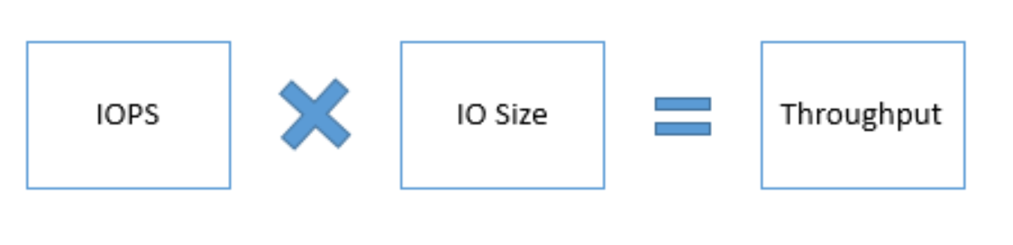
Counters to measure workload requirements
Counter | Description | PerfMon
Latency | Total time to complete a disk IO request. | Average Disk sec/Read Average disk sec/Write
IOPS or Transactions per second | Number of I/O requests issued to the storage disk per second. | Disk Reads/sec Disk Writes/sec
IO size | The size of I/O requests issues to the storage disks. | Average Disk Bytes/Read Average Disk Bytes/Write
Throughput | Amount of data read from or written to the disk per second. | Disk Read Bytes/sec Disk Write Bytes/sec
Max. Memory | Amount of memory required to run application smoothly | % Committed Bytes in Use
Max. CPU | Amount CPU required to run application smoothly | % Processor time
IOPS
Throughput
Latency
10000
64K
625MB/s

Slide 6
Workload performance indicators
Collect IOPS requirements of your current workload for Log, Data and Tempdb
On that base choose VM size that can fit your IOPS requirements
For Tempdb heavy workload choose VM with Local/Ephemeral SSD Drive
Choose VM with Premium SSD Drive Support and enable read only cache for Data drives (<4TB)
Use multiple disks and stripe them together to get a combined higher IOPS and Throughput limit.
If you need higher write throughput use Ultra Disk or Write Acceleration (Only M series)
Monitor performance to see if there are any throughput or IOPS bottlenecks.
If there is still bottlenecks consider using Ultra disks for Data files

Slide 7
Azure VM categories and series
Azure VM compute/size options
Naming convention explanation
Constrained vCPU VMs - SQL Server Licensing
SQL VM Memory Optimized Series - Recommended

Slide 8
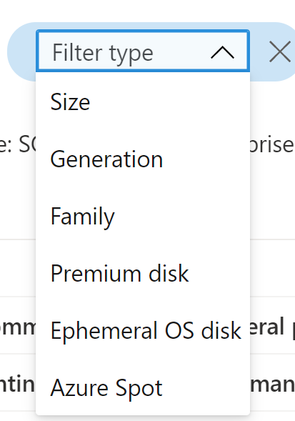
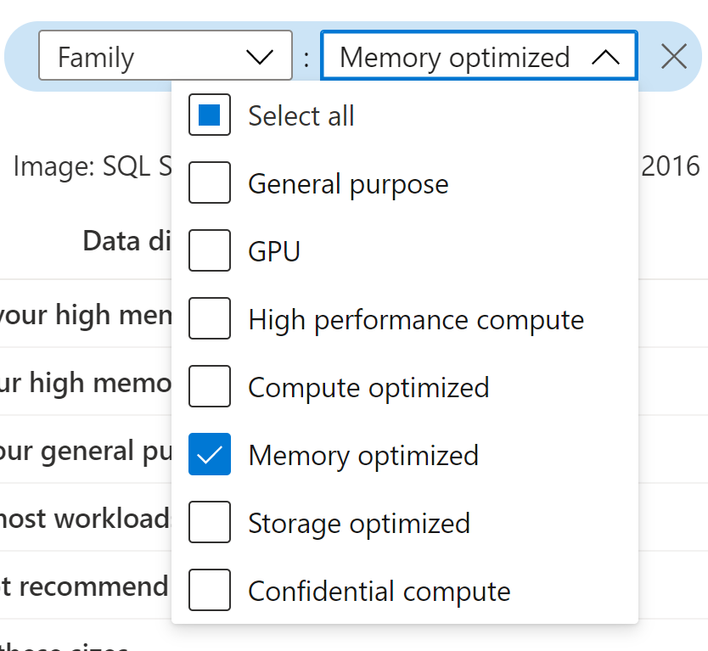
Azure VM compute/size options
Categories
Compute optimized – High CPU to memory ratio (F, Fs , Fsv2-series)
General purpose – Balanced CPU to memory ratio (D, DS-series, etc)
GPU (NC, NCsv3, NVv3-series)
High performance compute – High CPU and memory, fastest and most powerful CPU (A, H-series)
Memory optimized – High memory to CPU ratio (D, DS, Ea, Eas, Ed, Eds, Es, G, Gs, M, Ms, Mds-series)
Storage optimized – High disk throughput and IO (Ls, Lsv2-series)

Slide 9
Azure VM sizes naming conventions
Value | Explanation
Family | Indicates the VM Family Series
*Sub-family | Used for specialized VM differentiations only
# of vCPUs | The number of vCPUs of the VM
*Constrained vCPUs | Used for certain VM sizes only. Denotes the number of vCPUs for the constrained vCPU capable size
Additive Features | One or more lower case letters denote additive features, such as: d = disk (local temp disk is present); this is for newer Azure VMs, m = memory intensive; the most amount of memory in a particular size i = isolated size s = Premium Storage capable, including possible use of Ultra SSD (Note: some newer sizes without the attribute of s can still support Premium Storage e.g. M128, M64, etc.) h = hibernation capable a = AMD-based processor l = low memory; a lower amount of memory than the memory intensive size t = tiny memory; the smallest amount of memory in a particular size r = RDMA capable
M16ms
Family M
# of vCPUs 16
Additive Features:
m = memory intensive
s = Premium Storage capable
E32-16ds_v4
Family E
# of vCPUs 32
# of constrained (actual) vCPUs 16
Additive Features:
d = disk (local temp disk is present); this is for newer Azure VMs
s = Premium Storage capable
Version v4
[Family] + [Sub-family]* + [# of vCPUs] + [Constrained vCPUs]* + [Additive Features] + [Accelerator Type]* + [Version]

Slide 10
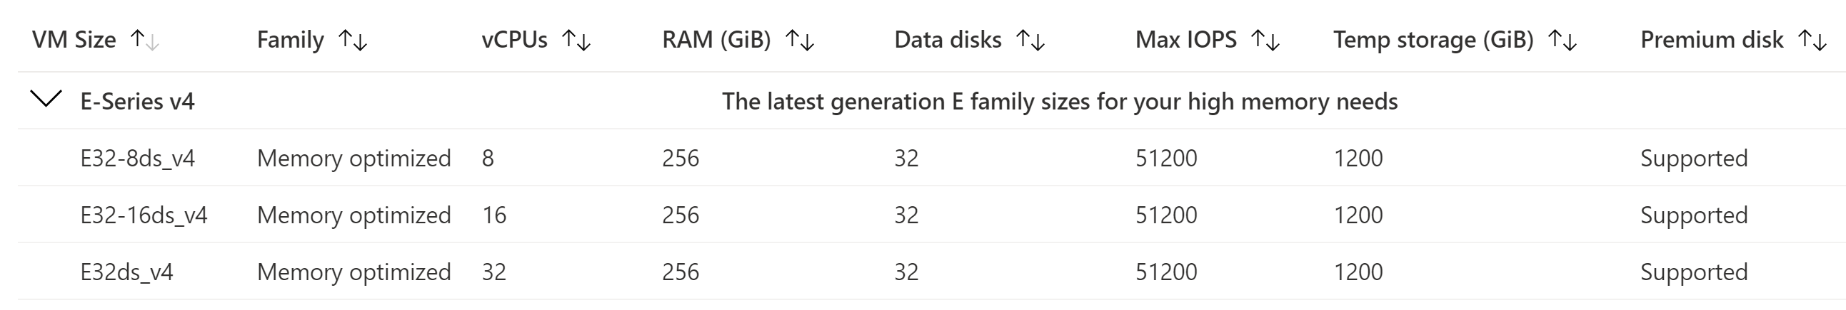
Constrained vCPU VMs - SQL Server Licensing
The vCPU count can be constrained to one half or one quarter of the original VM size. These new VM sizes have a suffix that specifies the number of active vCPUs to make them easier for you to identify.
You can get full VM spec in terms of memory, storage, and I/O bandwidth while optimizing software licensing cost

Slide 11
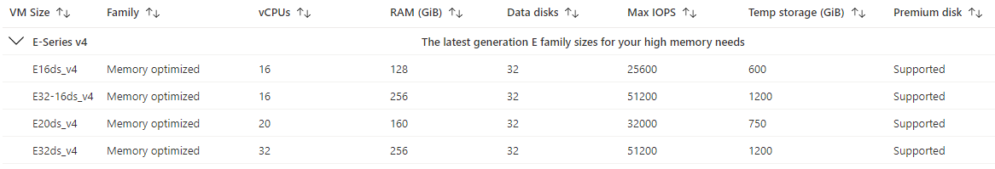
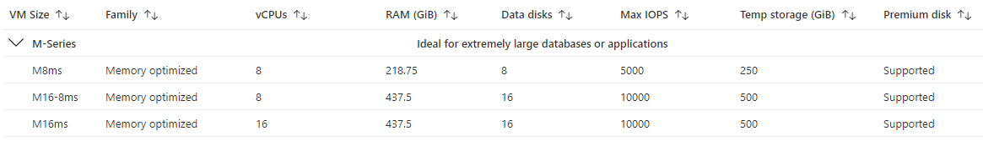
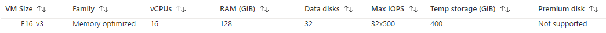
SQL VM Memory Optimized Series - Recommended
Old E16_v3 Example

Slide 12
Azure SQL Virtual Machine Storage Options and Configuration
Azure SQL VM Storage
Ultra Disks
Storage Pool, Storage Space and Volume
Block Size, Interleave and Columns
File and Storage Services user interface

Slide 13
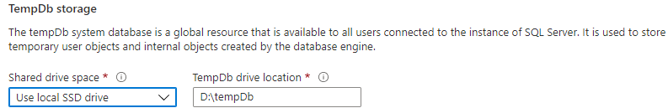
Azure SQL VM Storage
Detail | Ultra disk | Premium SSD | Standard SSD | Standard HDD
Disk type | SSD | SSD | SSD | HDD
Scenario | IO-intensive workloads, top tier databases (for example, SQL, Oracle), and other transaction-heavy workloads. | Production and performance sensitive workloads | Web servers, lightly used enterprise applications and dev/test | Backup, non-critical, infrequent access
Max disk size | 65,536 gibibyte (GiB) | 32,767 GiB | 32,767 GiB | 32,767 GiB
Max throughput | 2,000 MB/s | 900 MB/s | 750 MB/s | 500 MB/s
Max IOPS | 160,000 | 20,000 | 6,000 | 2,000
Local Ephemeral Disk
Use for Temp DB (D:\ ephemeral disk)

Slide 14
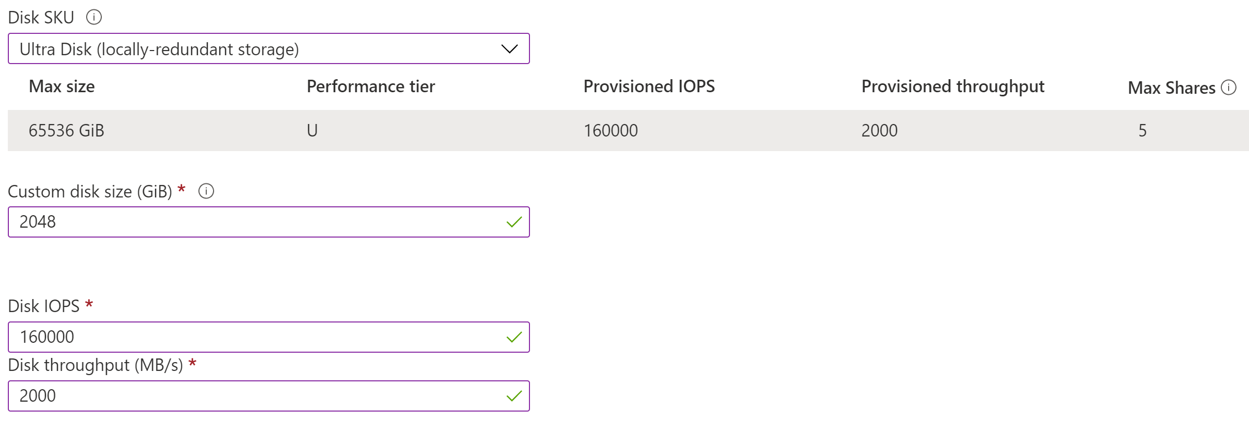
Ultra Disks
Disk Size Note.
You will be charged the same rate for your provisioned disk, regardless of how much of the disk space is being used.
For example, a 200 GB disk is provisioned on a 256 GB disk, so you would be billed for the 256 GB provisioned.
Azure ultra disks offer high throughput, high IOPS, and consistent low latency disk storage for Azure IaaS virtual machines (VMs).
Ultra disks are suited for data-intensive workloads, top tier databases, and transaction-heavy workloads.

Slide 15
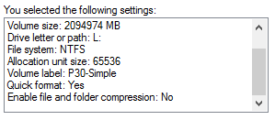
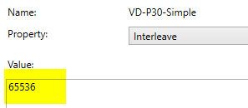
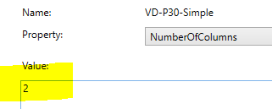
Block Size, Interleave and Columns
Block size is a measurement (usually in KB) of the I/Ops that the storage sub-system has to handle. Sequential workloads profit significantly from larger block sizes.
Stripe size (interleave size). To maximize performance, ensure that the interleave value used by the storage space is at least as large as the I/O size of your workload.
The number of columns specifies how many physical disk data is striped across and has an impact on performance regardless of stripe and block size. Storage Spaces intelligently scales the column count up to eight by default, but you can adjust this parameter by using Windows PowerShell.

Slide 16
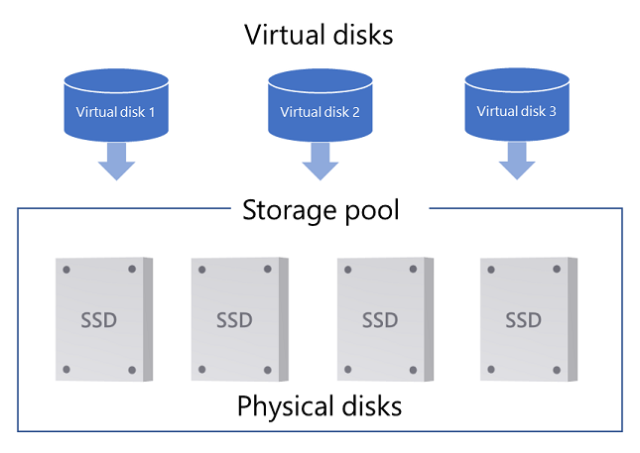
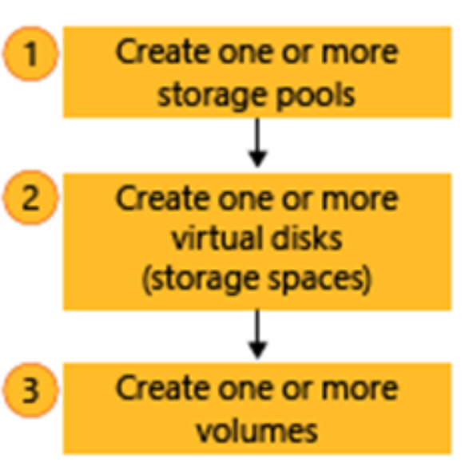
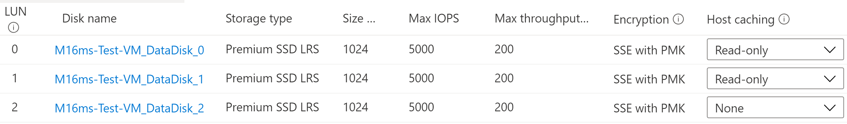
Storage Pool, Storage Space and Volume

Slide 17
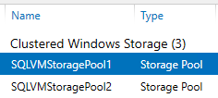
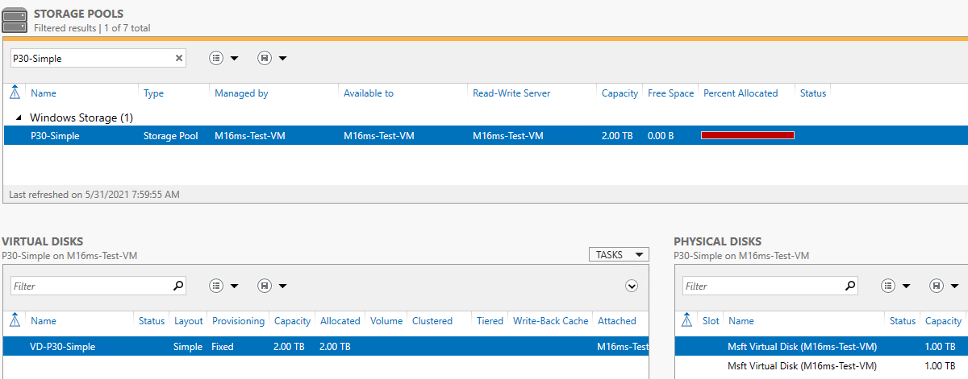
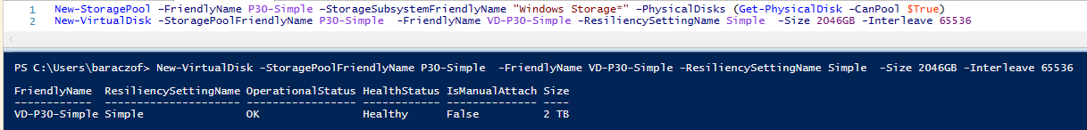
File and Storage Services user interface

Slide 18
Azure SQL VM Caching and Disk Throttling
Choose the right Azure VM size
Host VM Caching and IO Limits
Disk Caching – Read-only
Disk Caching – Read/Write
Azure VM IO Limits
Disk IO Limits
Write Accelerator - M Series

Slide 19
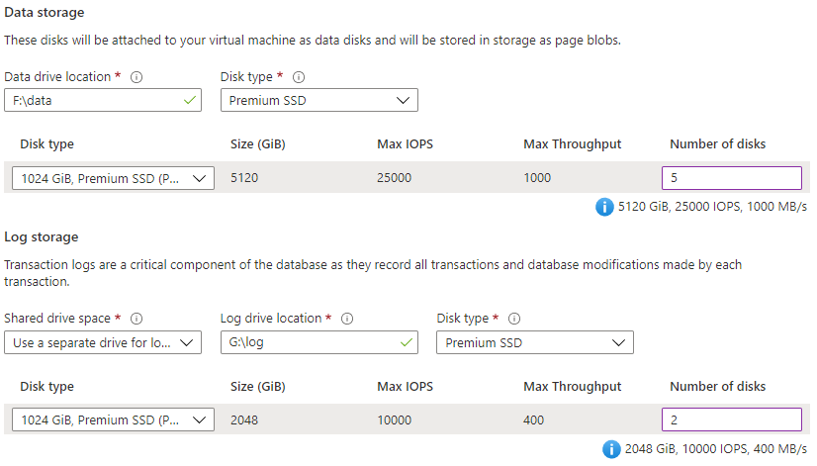
Choose the right Azure VM size
Example:
The selected VM size is E64-16s_v3 (16vCPU, 432GB RAM, 80000 IOPS (Uncached), 1200MBps)
Warning:
The desired performance might not be reached due to the maximum virtual machine disk performance cap. The selected VM size (Standard_E64-16s_v3) only supports up to 1200 disk max throughput in MBps (currently 1400 in MBps).

Slide 20
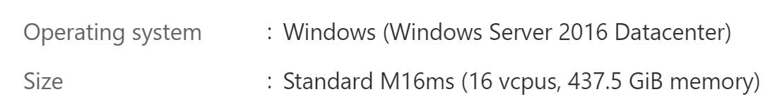
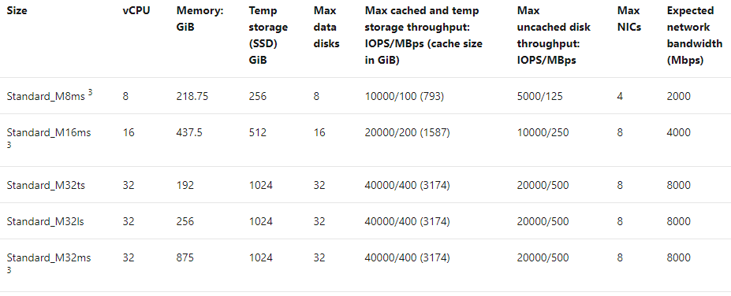
Host VM Caching and IO Limits
Virtual Machine
VM Spec
VM Disks

Slide 21
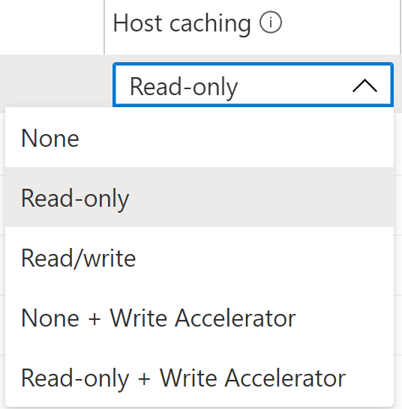
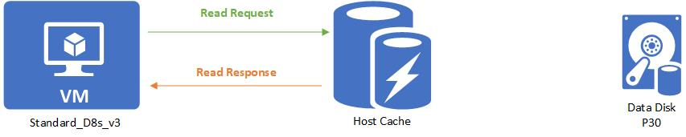
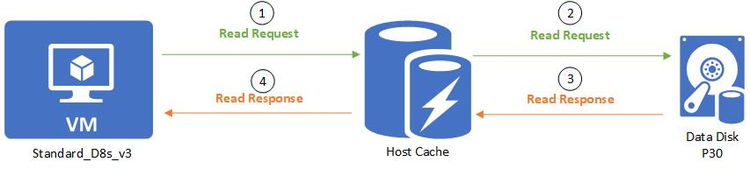
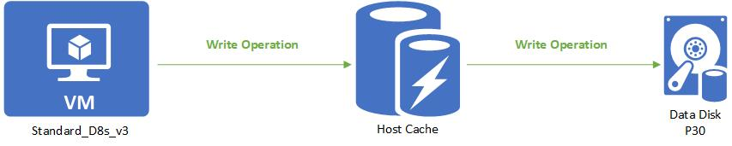
Disk Caching – Read-only

Slide 22
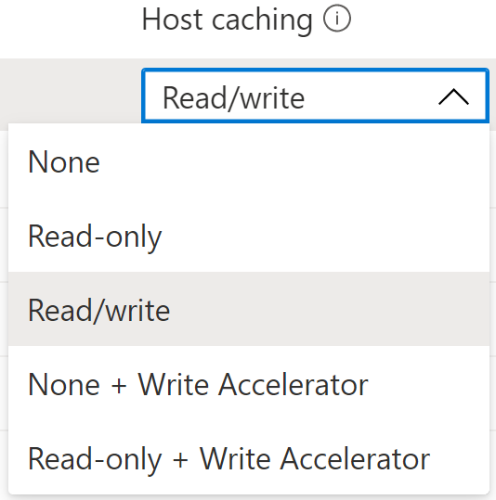

Disk Caching – Read/Write

Slide 23
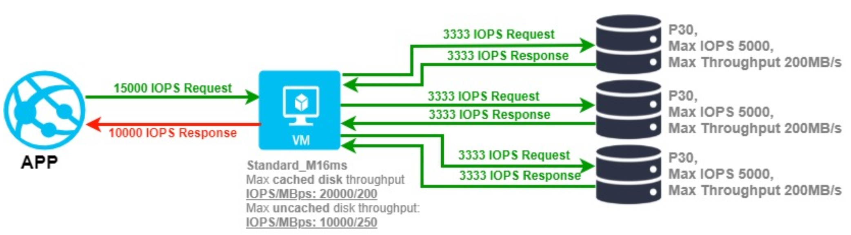
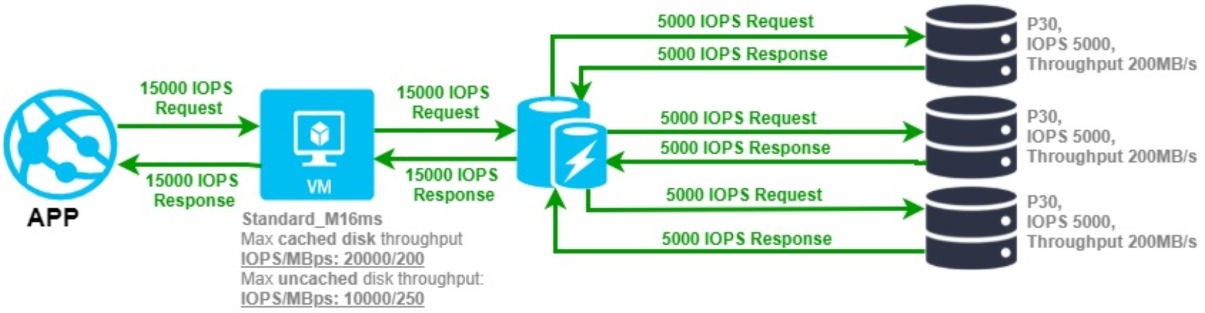
Azure VM IO Limits

Slide 24
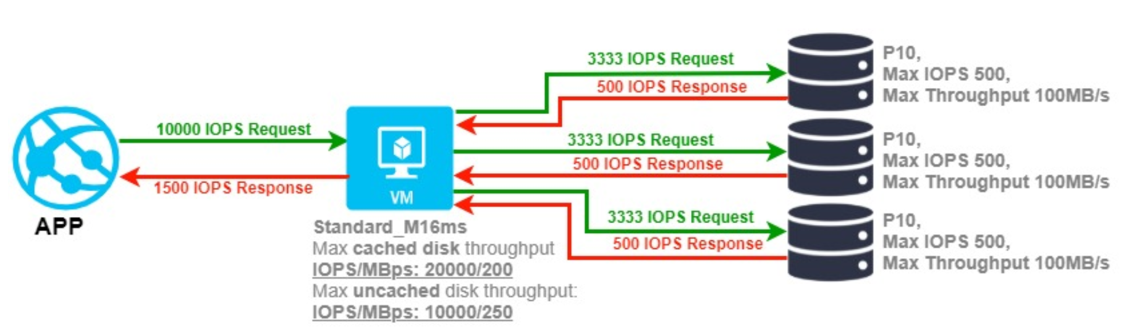
Disk IO Limits
Premium SSD sizes | P30 | P40 | P50
Disk size in GiB | 1,024 | 2,048 | 4,096
Provisioned IOPS per disk | 5,000 | 7,500 | 7,500
Provisioned Throughput per disk | 200 MB/sec | 250 MB/sec | 250 MB/sec
Eligible for reservation | Yes, up to one year | Yes, up to one year | Yes, up to one year

Slide 25
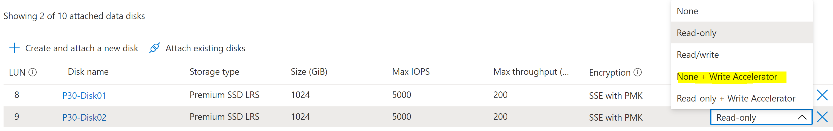
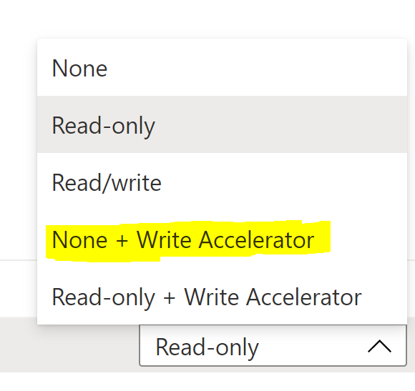
Write Accelerator - M Series
Write Accelerator is a disk capability for M-Series Virtual Machines (VMs) on Premium Storage with Azure Managed Disks exclusively.
The purpose of the functionality is to improve the I/O latency of writes against Azure Premium Storage.
Write Accelerator should be used for the volumes that contain the transaction log or redo logs of a DBMS. It is not recommended to use Write Accelerator for the data volumes of a DBMS as the feature has been optimized to be used against log disks

Slide 26
Benchmarking
Uncached vs Cached - Throughput
Uncached vs Cached - IOPS
Cached – CDM The Peak Performance + Mix
Azure Portal Metrics – Host Caching None
Azure Portal Metrics – Host Caching Read-Only
Most common Storage and VM size configuration recommendations

Slide 27
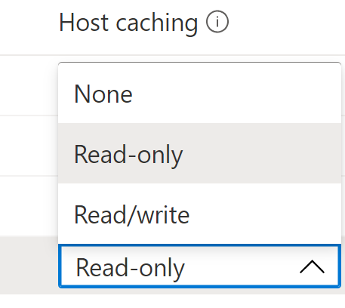
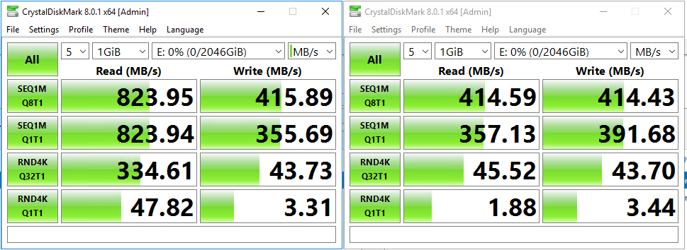
Uncached vs Cached - Throughput
Premium Disks: 2XP30, Simple (Stripe), 1 TB each, Size 2TB,
Max IOPS 10000, Max throughput (MBps) 400,
Allocation unit size 64K, Interleave 64K, 2 Columns
Azure VM Max uncached disk throughput: IOPS/MBps is 20000/500
Azure VM Max cached storage throughput: IOPS/MBps is 80000/800
Disk Capping
VM Capping

Slide 28
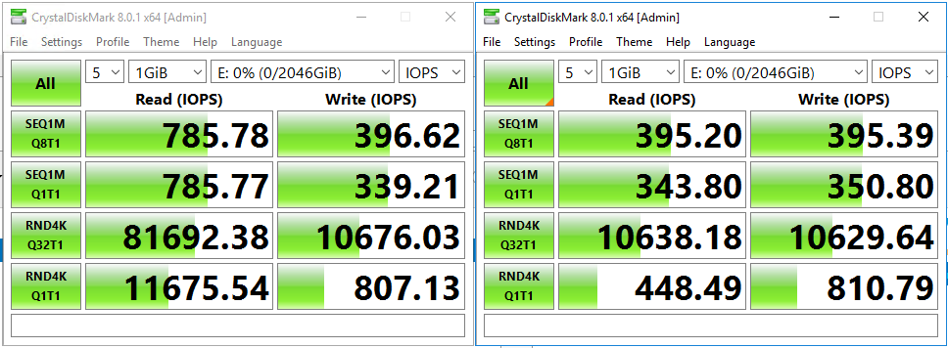
Uncached vs Cached - IOPS
Premium Disks: 2XP30, Simple (Stripe), 1 TB each, Size 2TB,
Max IOPS 10000, Max throughput (MBps) 400,
Allocation unit size 64K, Interleave 64K, 2 Columns
Azure VM Max uncached disk throughput: IOPS/MBps is 20000/500
Azure VM Max cached storage throughput: IOPS/MBps is 80000/800
Disk Capping
VM Capping

Slide 29
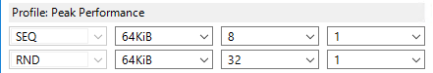
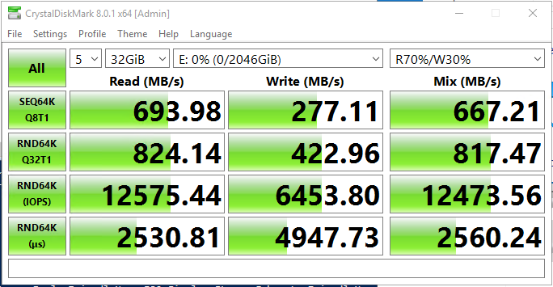
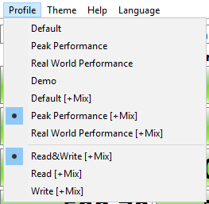
Cached – CDM The Peak Performance + Mix

Slide 30
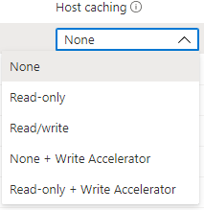
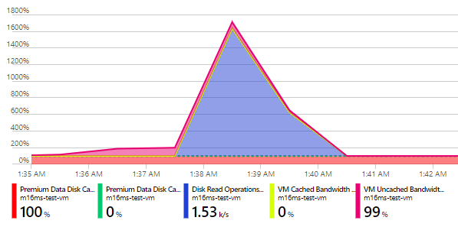
Azure Portal Metrics – Host Caching None
Premium Data Disk Cache Read Miss (Max)
Premium Data Disk Cache Read Hit (Max)
Disk Read Operations/Sec (Max)
VM Cached Bandwidth Consumed Percentage (Max)
VM Uncached Bandwidth Consumed Percentage (Max)

Slide 31
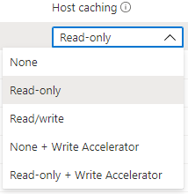
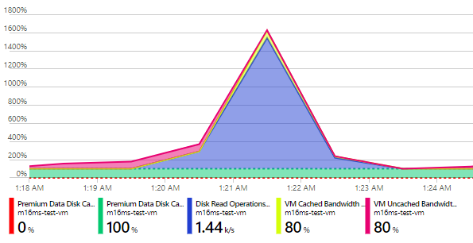
Azure Portal Metrics – Host Caching Read-Only
Premium Data Disk Cache Read Miss (Max)
Premium Data Disk Cache Read Hit (Max)
Disk Read Operations/Sec (Max)
VM Cached Bandwidth Consumed Percentage (Max)
VM Uncached Bandwidth Consumed Percentage (Max)

Slide 32
Most common Storage and VM size configuration recommendations
Use memory optimized virtual machine sizes for the best performance of SQL Server workloads.
Use the Azure Virtual Machine marketplace images as the SQL Server settings and storage options are configured for optimal SQL Server performance.
Place data, log, and tempdb files on separate drives.
For the data drive, only use premium P30 and P40 disks to ensure the availability of cache support.
For the log drive try with P30 disks If sub-millisecond storage latency is required, use Azure ultra disks for the LDF.
In case of M-series VM consider Write Accelerator over using Azure ultra disks.
Place tempdb on the local ephemeral SSD D:\ drive after choosing the optimal VM size.
Stripe multiple Azure data disks to increase I/O bandwidth up to the target virtual machine's IOPS and throughput limits.
Set host caching to read-only for data file disks.
Set host caching to none for log file disks.
Format your data disk to use 64 KB allocation unit size for all data files, interleave same size as IO size, have proper number of columns.

Slide 33
Q&A
ZORAN BARAC, Principal Data Architect @ CIN7
MCT, MCSE
zoran.barac.zof@gmail.com
blog.sqlserveronline.com
www.linkedin.com/in/zoran-barac/
www.meetup.com/Auckland-SQL-User-Group/

